Slide 1
Subscription Tracking Application
Subscription Tracking Application
Presented by:
Ankit Aryan
Shasank M Shah
Puneet Solanki

Slide 2
Subscription Tracking Application
Introduction
Objectives
  Track all subscriptions in one application.
  Display monthly and yearly subscription expenses.
  Notify users about upcoming renewals.
  Help users save money through better expense management.
Main Features
  User Registration and Login
  Subscription CRUD (Create, Read, Update, Delete)
  Dashboard Analytics
  Renewal Tracking
  Secure Data Storage
The Subscription Tracking Application is a web-based system designed to help users manage all of their subscriptions in one place. Many people subscribe to services such as Netflix, Spotify, JioHotstar, cloud storage, gyms, and software platforms. Over time, it becomes difficult to remember renewal dates and total expenses, resulting in unnecessary payments.

Slide 3
Subscription Tracking Application
Organization Profile
Project Name: Subscription Tracking Application
Project Type: Web Application
Developed By: Ankit Aryan,Shasank M Shah,Puneet Solanki(MCA Mini Project)
The MERN Stack (Modern)
Frontend: React.js, Tailwind CSS.
Backend: Node.js, Express.js.
Database: MongoDB.
Target Users
  Students
  Working professionals
  Families
  Small businesses

Slide 4
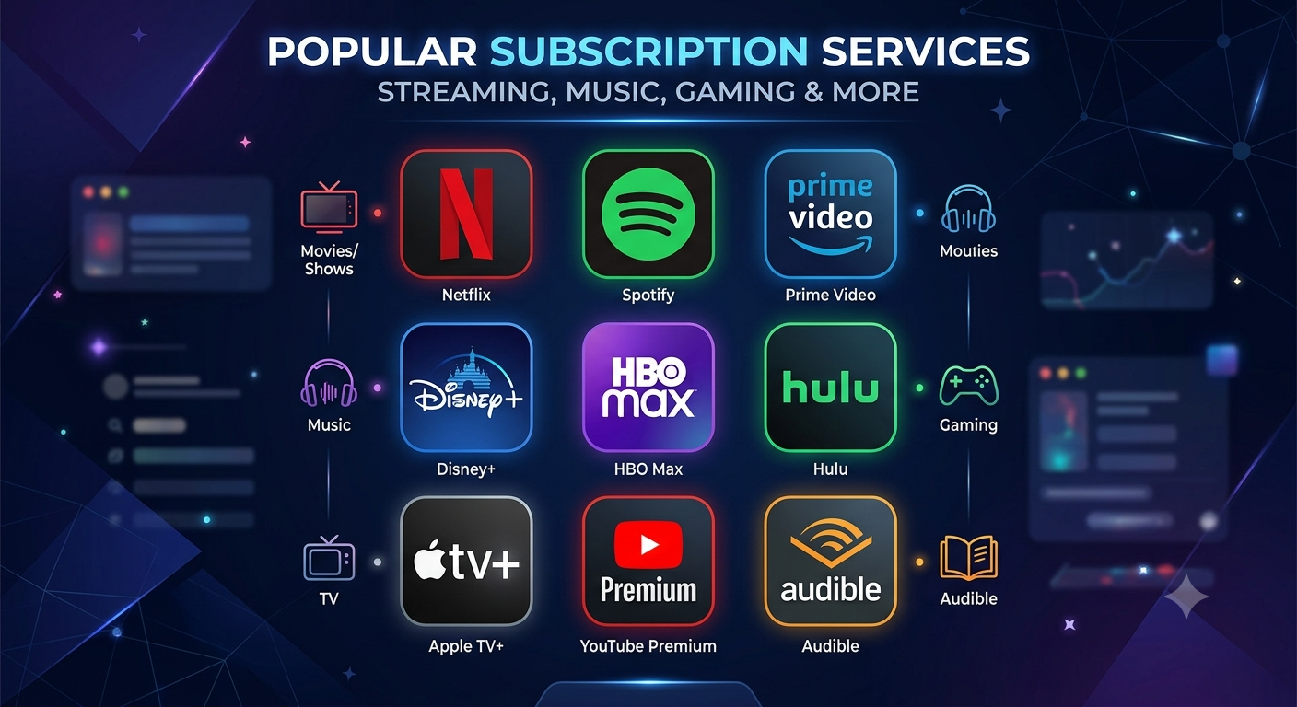
Subscription Tracking Application
Existing System
At present, there is no single platform where users can manage all their subscriptions.
People generally use:
  Mobile reminders
  Calendar applications
  Paper notes
  Excel spreadsheets
  Memory
Disadvantages
  Information is scattered.
  Users forget renewal dates.
  Difficult to calculate expenses.
  No analytics or reports.
  No centralized dashboard.

Slide 5
Subscription Tracking Application
Problem Areas of Existing System
The existing approach has several limitations.
  Users forget renewal dates.
  Money is wasted on unused subscriptions.
  No automatic reminders.
  No centralized management.
  Expense calculation is manual.
  Difficult to compare monthly and yearly spending.
  No secure storage for subscription details.

Slide 6
Subscription Tracking Application
Need for the New System
User Authentication
Only registered users can access their subscription information.
Subscription Management
Users can:
  Add subscriptions
  Edit subscriptions
  Delete subscriptions
  View subscription details

Slide 7
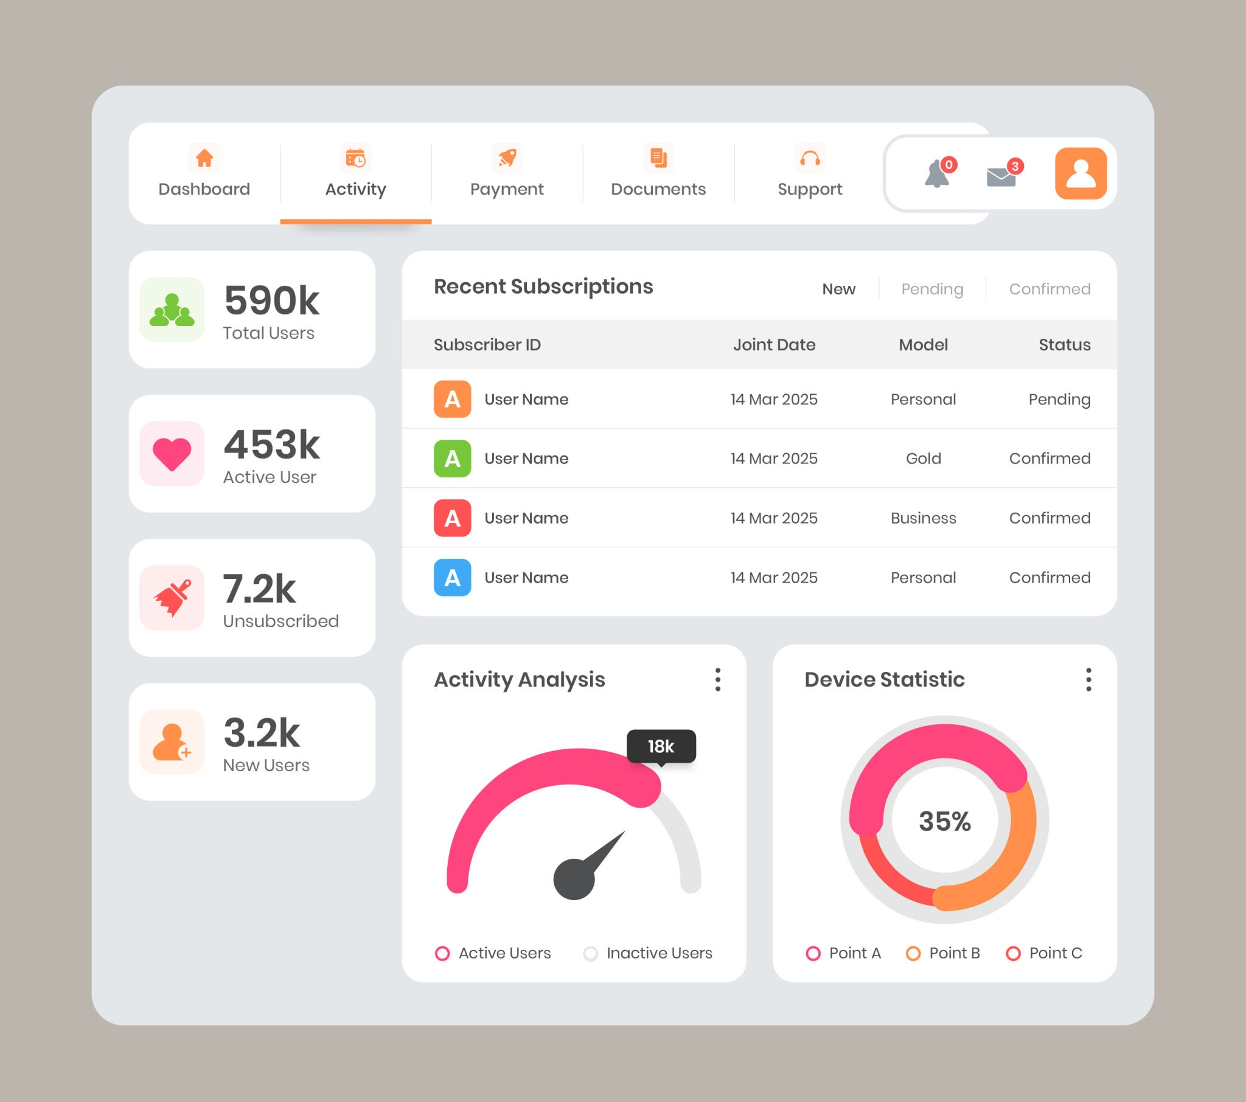
Subscription Tracking Application
Dashboard
The dashboard displays:
  Total monthly spending
  Total yearly spending
  Upcoming renewals
  Subscription summary
Additional Benefits
  Saves money
  Saves time
  Improves financial planning
  Better user experience
  Easy to manage multiple subscriptions
  Secure database storage

Slide 8
Subscription Tracking Application
System Flow Diagram
Start
│
▼
User Registration/Login
│
▼
User Dashboard
│
▼
Add Subscription Details
│
▼
Validate User Input
│
▼
Save Data into Database
│
▼
Calculate Monthly/Yearly Cost
│
▼
Display Dashboard Analytics
│
▼
Upcoming Renewal Reminders
│
▼
End
Working Process
  User logs into the application.
  The user adds subscription information (service name, cost, billing cycle, renewal date).
  The system stores the information in the database.
  The backend calculates monthly and yearly expenses.
  The dashboard displays analytics and upcoming renewal dates.
  The user can update or delete subscriptions whenever needed.

Slide 9
Subscription Tracking Application
Thank
You

